Slide 1
Module4 Introduction to ASSET-ABCKED SECURITIES
COMMERCIAL MORTGAGE-BACKED SECURITIES
Commercial mortgage-backed securities (CMBS) are backed by a pool of commercial mortgages on income-producing property, such as multifamily properties (e.g., apartment buildings), office buildings, industrial properties (including warehouses), shopping centers, hotels, and health care facilities (e.g., senior housing care facilities).

Slide 2
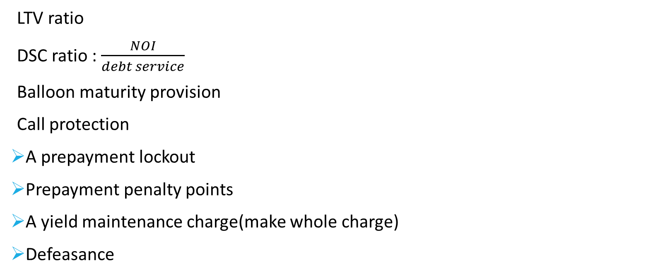
Module4 Introduction to ASSET-ABCKED SECURITIES
LTV ratio
DSC ratio : $\frac{NOI}{debt service}$
Balloon maturity provision
Call protection
A prepayment lockout
Prepayment penalty points
A yield maintenance charge(make whole charge)
Defeasance

Slide 3
practices
1. Defeasance can be best described as:
A. a predetermined penalty that a borrower who wants to refinance must pay to do so.
B. a contractual agreement that prohibits any prepayments during a specified period of time.
C. funds that the borrower must provide to replicate the cash flows that would exist in the absence of prepayments.

Slide 4
practices
2. A risk that investors typically face when holding CMBS is:
A. call risk.
B. balloon risk.
C. contraction risk.
3. The credit risk of a commercial mortgage-backed security is lower:
A. the lower the DSC ratio and the lower the LTV.
B. the lower the DSC ratio and the higher the LTV.
C. the higher the DSC ratio and the lower the LTV.

Slide 5
Module4 Introduction to ASSET-ABCKED SECURITIES
NON-MORTGAGE ASSET-BACKED SECURITIES
Auto loan ABS
Class | Initial note principal balance | Interest rate | Final scheduled distribution date
A-1 (senior) | 168,000,000 | 0.25 | 8 August 2020
A-2 (senior) | 279,000,000 | 0.74 | 8 November 2022
A-3 (senior) | 192,260,000 | 0.96 | 9 April 2024
B (subordinated) | 68,870,000 | 1.66 | 10 September 2024
C (subordinated) | 85,480,000 | 2.72 | 9 September 2025
D (subordinated) | 84,060,000 | 3.31 | 8 October 2025
E (subordinated) | 22,330,000 | 4.01 | 8 January 2027

Slide 6
Module4 Introduction to ASSET-ABCKED SECURITIES
The collateral for this securitization is a pool of subprime automobile loan contracts secured for new and used automobiles and light-duty trucks and vans. The issuing entity will issue seven sequential-pay classes of asset-backed notes pursuant to the indenture.
On the closing date, the initial amount of overcollateralization is approximately US$49,868,074, or 5.25% of the aggregate principal balance of the automobile loan contracts as of the cutoff date. On the closing date, 2.0% of the expected initial aggregate principal balance of the automobile loan contracts will be deposited into the reserve account, which is approximately US$18,997,361.

Slide 7
Module4 Introduction to ASSET-ABCKED SECURITIES
1. The reference to subprime meant that:
A. the asset-backed notes were rated below investment grade.
B. the automobile (auto) loan contracts were made to borrowers who did not have or could not document strong credit.
C. some of the auto loan contracts were secured by autos of low quality that may have been difficult to sell in case the borrower defaults.
2. Based on the information provided, if on the first distribution date there were losses on the loans of US$10 million:
A. none of the classes of notes will have incurred losses.
B. Class E notes will have incurred losses of US$10 million.
C. Classes B, C, D, and E will have incurred losses pro rata of their initial note principal balances.

Slide 8
Module4 Introduction to ASSET-ABCKED SECURITIES
3. Based on the information provided, if the first loss on the loans was US$40 million over and above the protection provided by the internal credit enhancements and occurred in January 2020, which class(es) of notes realized losses?
A. Class E and then Class D
B. Each class of subordinated notes in proportion to its principal balance
C. Class E and then each class of subordinated notes in proportion to its principal balance

Slide 9
Module4 Introduction to ASSET-ABCKED SECURITIES
NON-MORTGAGE ASSET-BACKED SECURITIES
Credit card receivable ABS
For a pool of credit card receivables, the cash flows consist of finance charges collected, fees, and principal repayments.
Some provisions in credit card receivable ABS require early principal amortization if specific events occur.
As noted earlier, the collateral of credit card receivable ABS is a pool of non amortizing loans. These loans have lockout periods during which the cash flows that are paid out to security holders are based only on finance charges collected and fees.

Slide 10
Module4 Introduction to ASSET-ABCKED SECURITIES
NON-MORTGAGE ASSET-BACKED SECURITIES
Credit card receivable ABS
The lockout or revolving period is the period during which the principal repaid is reinvested to acquire additional loans with a principal equal to the principal repaid.
When the lockout period is over, the principal that is repaid by the cardholders is no longer reinvested but instead is distributed to investors.

Slide 11
practices
1. Credit card receivable asset-backed securities differ from auto loan ABS in the following way:
A. credit card loans are recourse loans, whereas auto loans are non-recourse loans.
B. the collateral for credit card receivable-backed securities is a pool of non-amortizing loans, whereas the collateral for auto loan ABS is a pool of amortizing loans.
C. credit card receivable-backed securities have regular principal repayments, whereas auto loan ABS include a lockout period during which the cash proceeds from principal repayments are reinvested in additional loan receivables.

